Slide 1
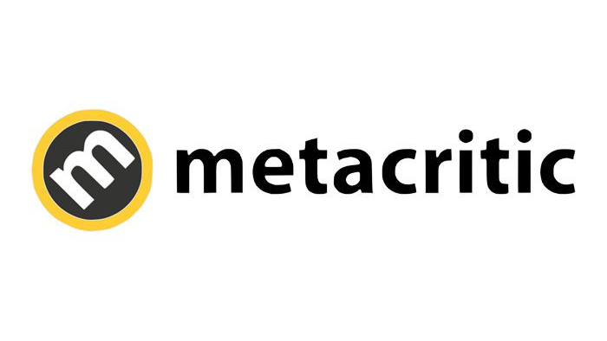
Critic Review Analysis
Hanxiao(Mia) Zhang

Slide 2
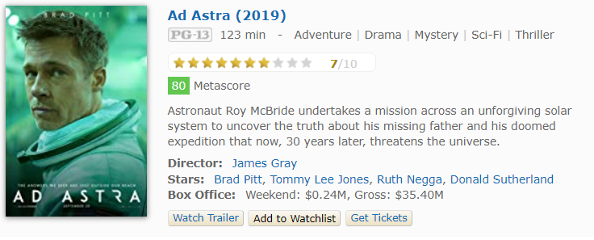
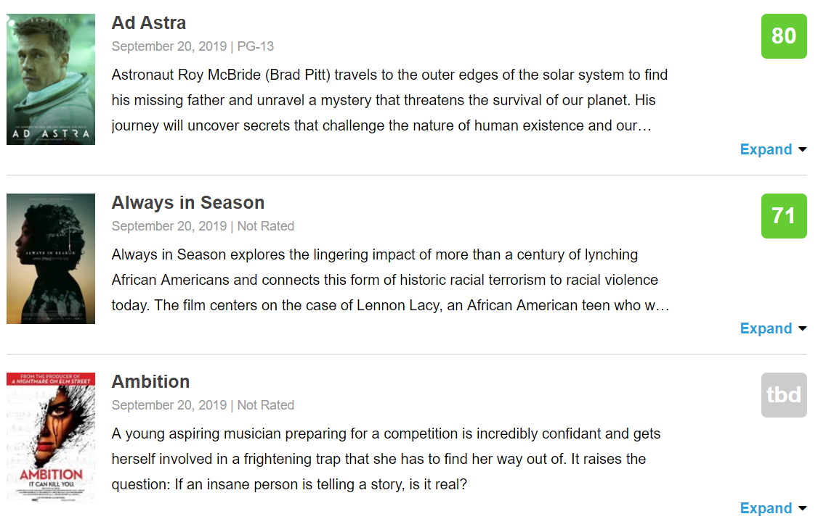
IMDb
About Metacritic
Launched in January 2001, Metacritic has evolved over the last decade to distill critics' voices into a single Metascore, a weighted average of the most respected critics writing reviews online and in print.
Metacritic

Slide 3
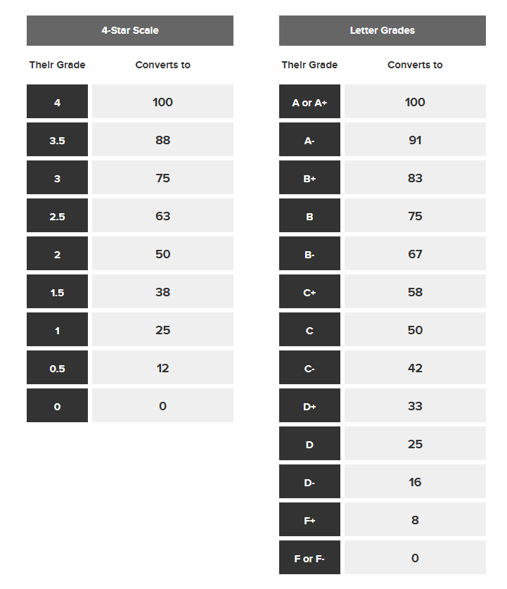
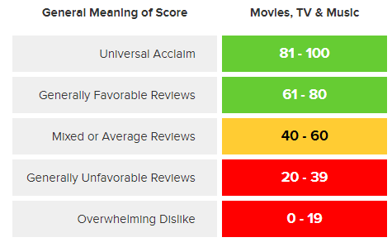
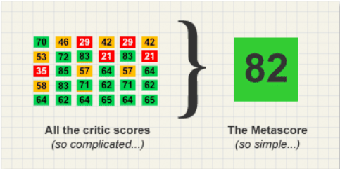
How To Create A Metascore

Slide 4




JOKER
Todd Phillips' controversial Joker origin story won Venice. Is an Oscar nomination next?
PARASITE
Bong Joon-ho's savagely funny Cannes winner could be 2019's best film.

Slide 5
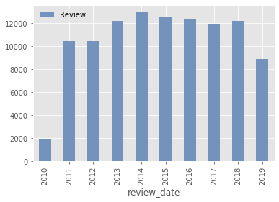
Data Summary
Metacritic Annual Reviews
247,009 Reviews & Scores
Once Upon a Time in Hollywood – 61 Reviews
12,635 Movies
25 Genres, 1,244 Distributors
3,069 Critics
Roger Ebert from Chicago Sun-Times wrote 4,753 reviews
273 Media Outlets
Multiple reviews from the same media is possible

Slide 6
Word Cloud
Sentiment Analysis

Slide 7
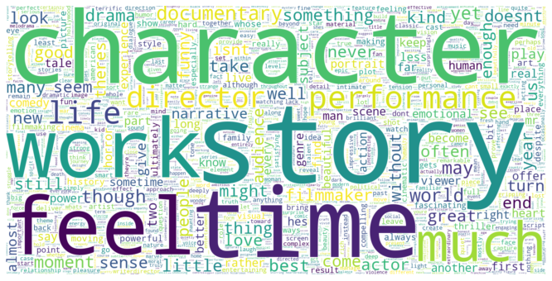
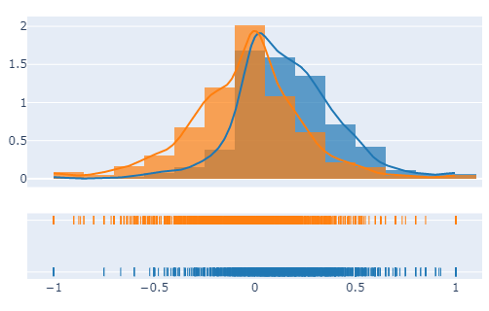
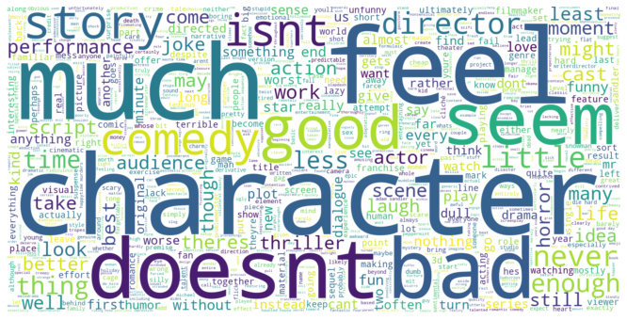

>70
Review Sentiment Analysis
<30

Slide 8
Movie Genre
Metascore VS Userscore

Slide 9
>70

Slide 10
<30

Slide 11
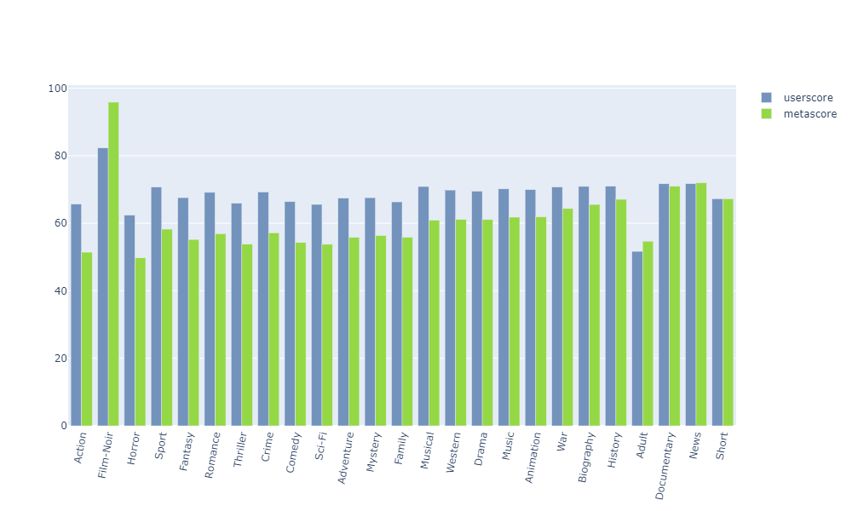
Critic & User Genre Preference

Slide 12
Review Date

Slide 13
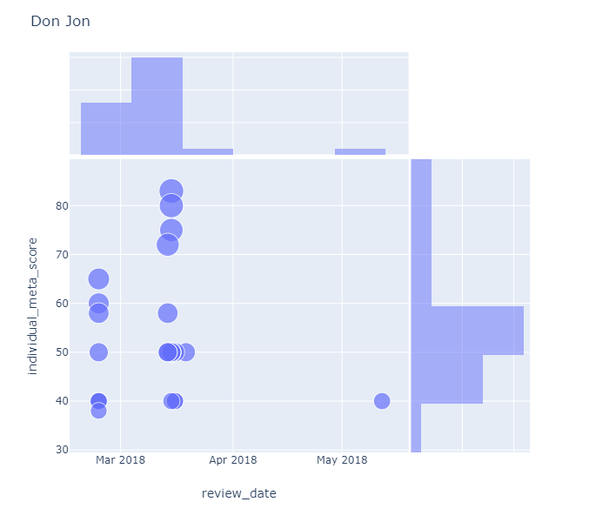
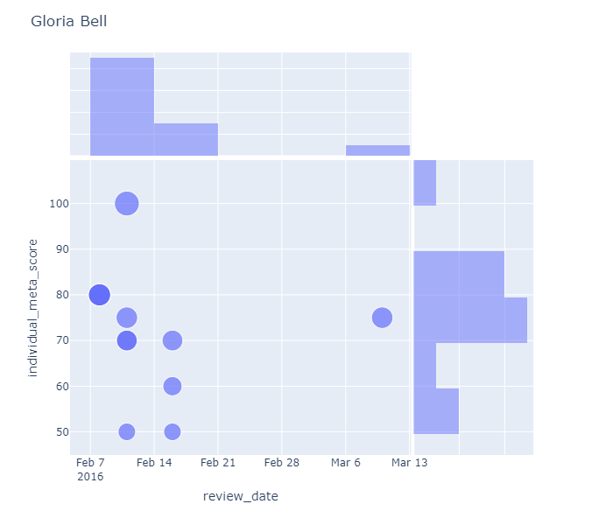
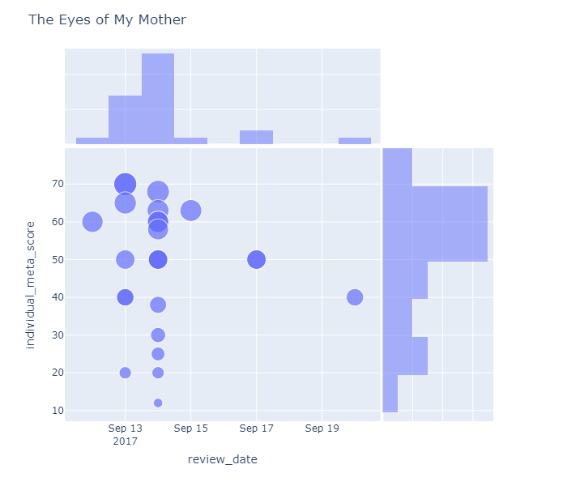
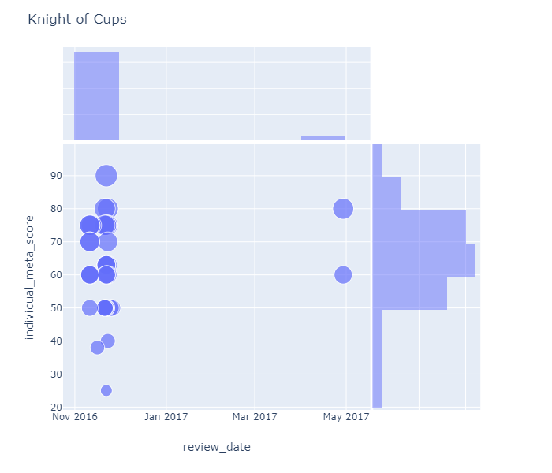
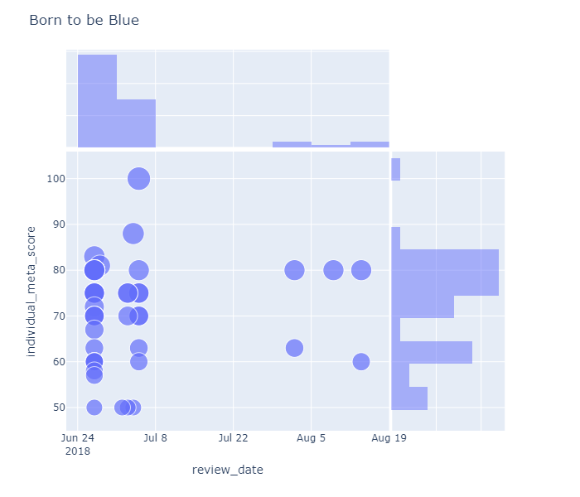
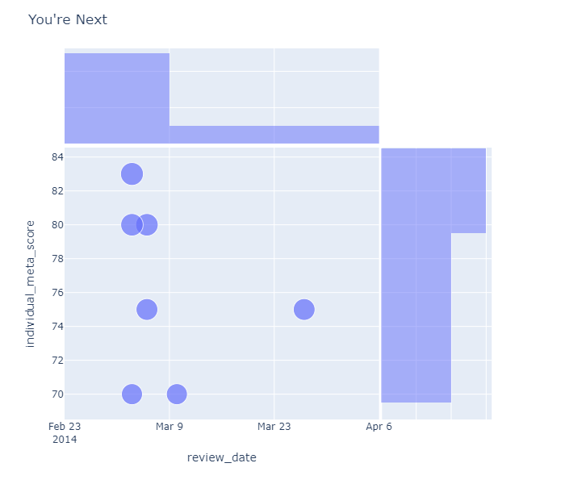

Slide 16
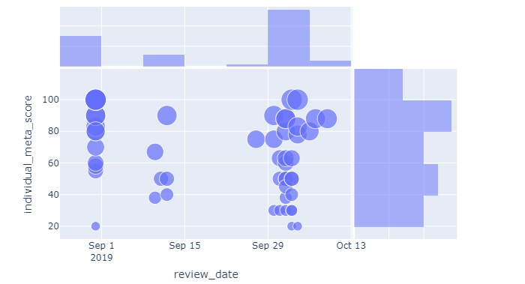
Joker Review Published Date Analysis
Venice Movie Festival
Movie Release
Metascore 59
The New York Times 30
The New Yorker 30
The New Yorker 20
The WSJ 20
Time 20
Critic Screening

Slide 17
Conclusion

Slide 18
Genre Preferences
Review Date
Critics prefer documentary, drama, history to horror, action movies
Reviews come out mainly before and around movie release, which results in Metascore changing over time.
Review Score
Metascore Calculation
Scores are higher before release date and mixed around and after.
The media outlet included in the calculating pool and their weights matter

Slide 19
THANK YOU

